Slide 1
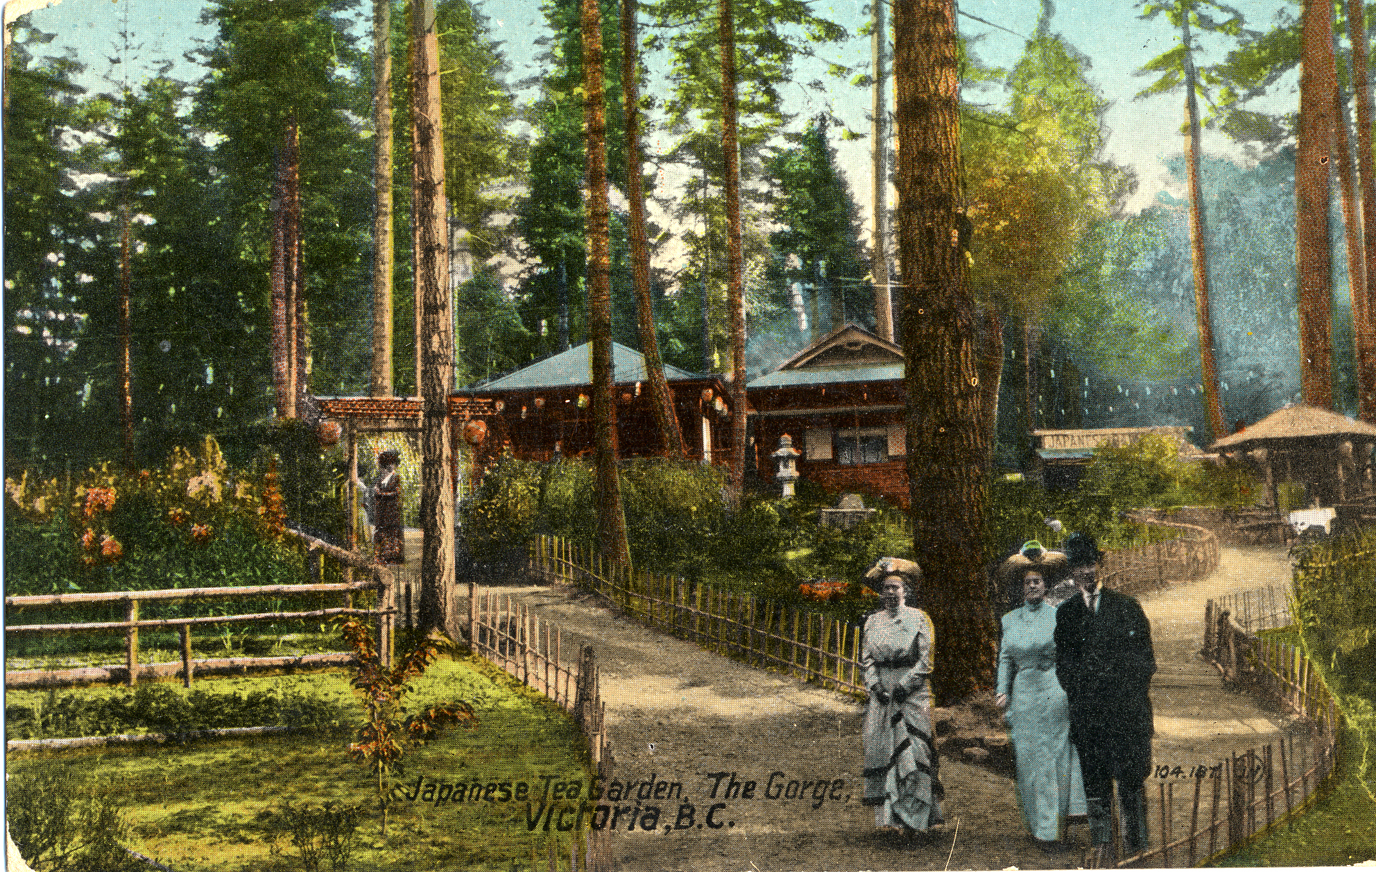

Slide 2


Greetings Tom August 23, 1938
Having a splendid time, can’t believe this will be gone someday. We must do everything possible to preserve it. Vote to commemorate this garden. https://www.esquimalt.ca/municipal-hall/mcloughlin-amenity-funds and be sure to select Japanese Teahouse under Esquimalt Gorge Park.
You might have to upgrade your computer to Windows 38.
Love Millie
Greetings Tom August 23, 1938
Having a splendid time, can’t believe this will be gone someday. We must do everything possible to preserve it. Vote to commemorate this garden. https://www.esquimalt.ca/municipal-hall/mcloughlin-amenity-funds and be sure to select Japanese Teahouse under Esquimalt Gorge Park.
You might have to upgrade your computer to Windows 38.
Love Millie
Greetings Tom August 23, 1938
Having a splendid time, can’t believe this will be gone someday. We must do everything possible to preserve it. Vote to commemorate this garden. https://www.esquimalt.ca/municipal-hall/mcloughlin-amenity-funds and be sure to select Japanese Teahouse under Esquimalt Gorge Park.
You might have to upgrade your computer to Windows 38.
Love Millie
Greetings Tom August 23, 1938
Having a splendid time, can’t believe this will be gone someday. We must do everything possible to preserve it. Vote to commemorate this garden. https://www.esquimalt.ca/municipal-hall/mcloughlin-amenity-funds and be sure to select Japanese Teahouse under Esquimalt Gorge Park.
You might have to upgrade your computer to Windows 38.
Love Millie

